Slide 1
Optimization

Slide 2

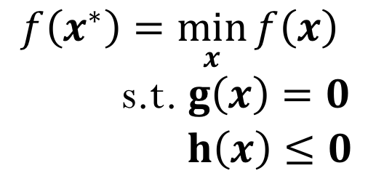
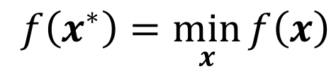
Optimization
Goal: Find the minimizer $x^{∗}$that minimizes the objective (cost) function $f\left(x\right):ℛ^{n}→ℛ$
Unconstrained Optimization
$$f\left(x^{∗}\right)=\min_{x}{f\left(x\right)}$$
Constrained Optimization
$$f\left(x^{∗}\right)=\min_{x}{f\left(x\right)}$$
s.t. $g\left(x\right)=0$
$h\left(x\right)≤0$
Equality constraints
Inequality constraints

Slide 3
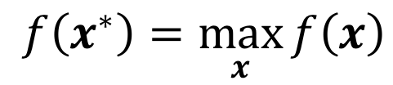
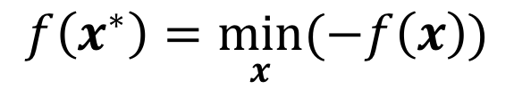
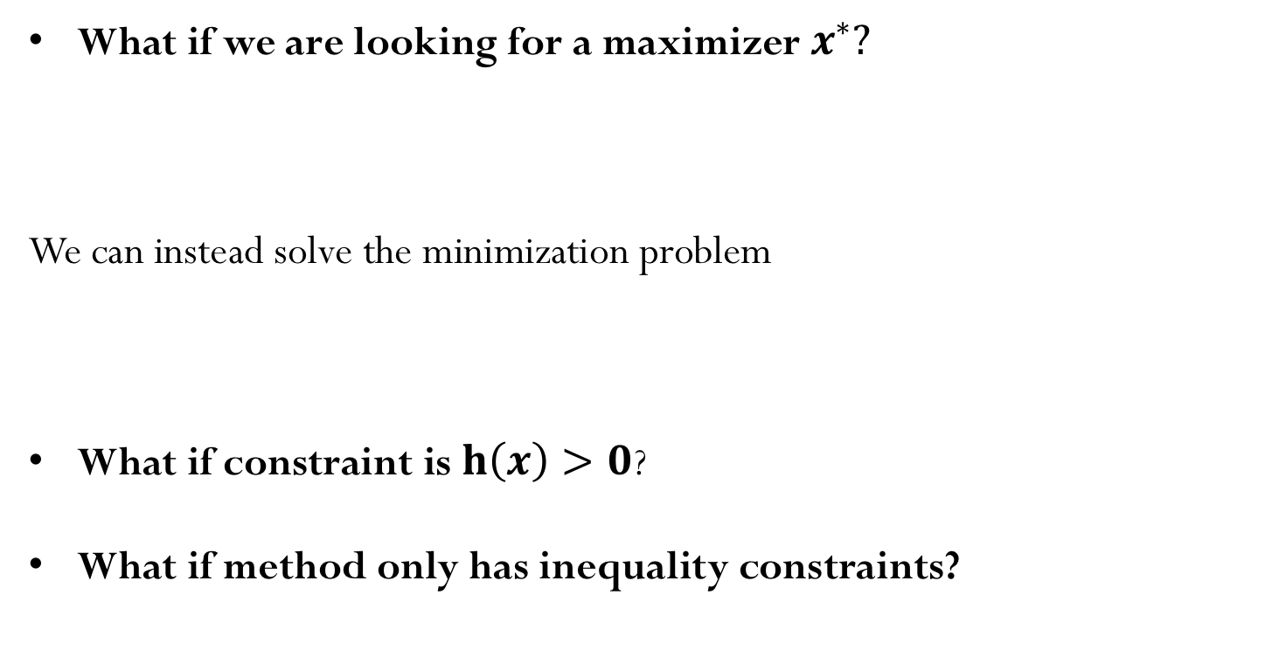
Optimization
What if we are looking for a maximizer $x^{∗}?$
We can instead solve the minimization problem
What if constraint is $h\left(x\right)>0$?
What if method only has inequality constraints?
$$f\left(x^{∗}\right)=\max_{x}{f\left(x\right)}$$
$$f\left(x^{∗}\right)=\min_{x}{(−f\left(x\right))}$$

Slide 4

Calculus problem: maximize the rectangle area subject to perimeter constraint
$$\max_{d ∈{ ℛ}^{2}}{ }$$
Demo: Constrained-Problem-2D

Slide 5
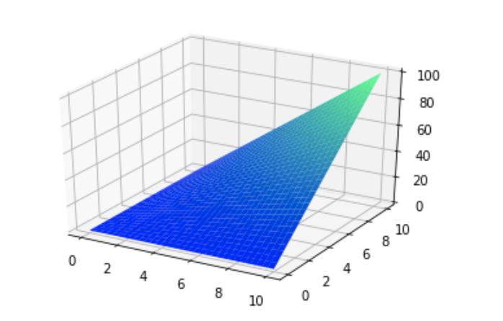
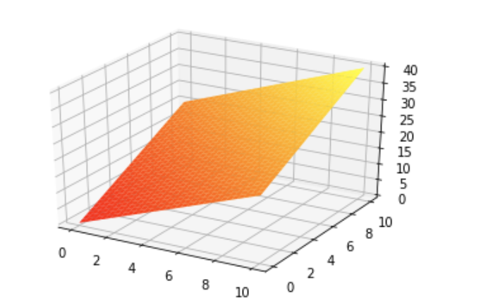
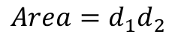
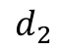
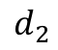
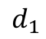
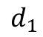
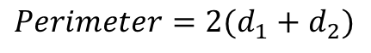
$$Area=d_{1}d_{2}$$
$$d_{2}$$
$$d_{1}$$
$$Perimeter=2(d_{1}+d_{2})$$
$$d_{2}$$
$$d_{1}$$

Slide 7
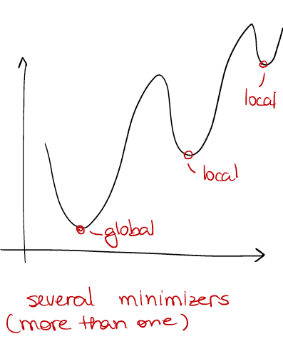
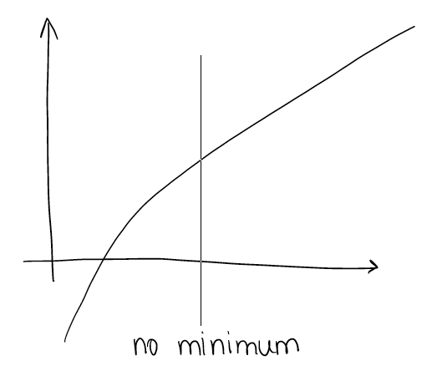
Does the solution exists? Local or global solution?

Slide 8
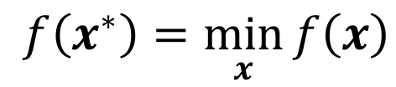
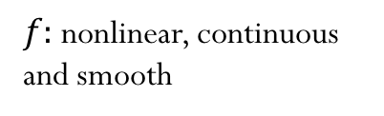
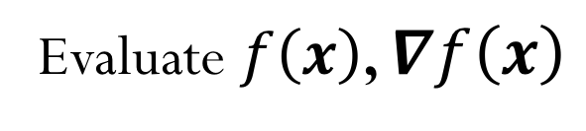
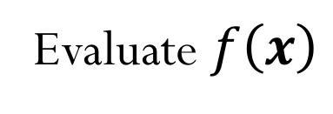
Types of optimization problems
$$f\left(x^{∗}\right)=\min_{x}{f\left(x\right)}$$
$f:$ nonlinear, continuous and smooth
Gradient-free methods
Evaluate $f\left(x\right)$
Gradient (first-derivative) methods
Evaluate $f\left(x\right)$, $∇f\left(x\right)$
Second-derivative methods
Evaluate $f\left(x\right)$, $∇f\left(x\right),∇^{2}f\left(x\right)$

Slide 9
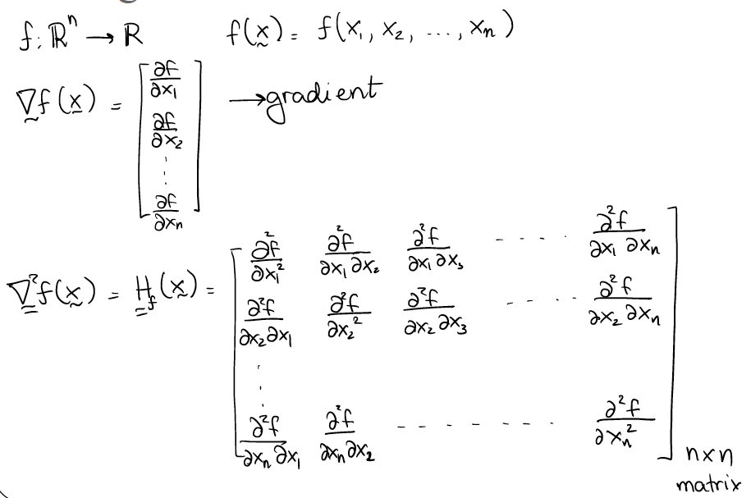
Taking derivatives…

Slide 10
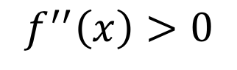
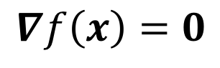
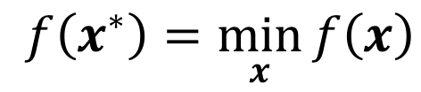
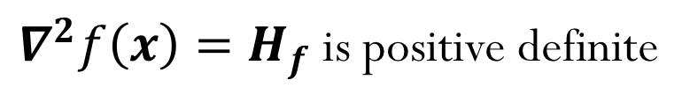
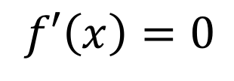
What is the optimal solution?
$$f\left(x^{∗}\right)=\min_{x}{f\left(x\right)}$$
(First-order) Necessary condition
$$f′\left(x\right)=0$$
$$∇f\left(x\right)=0$$
(Second-order) Sufficient condition
$$f^{′′}\left(x\right)>0$$
$∇^{2}f\left(x\right){=H}_{f}$is positive definite

Slide 12
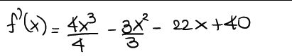
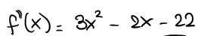
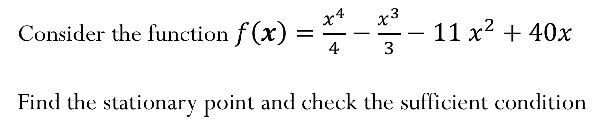
Example (1D)
Consider the function $f\left(x\right)=\frac{x^{4}}{4}−\frac{x^{3}}{3}−{11 x}^{2}+40x$
Find the stationary point and check the sufficient condition

Slide 13
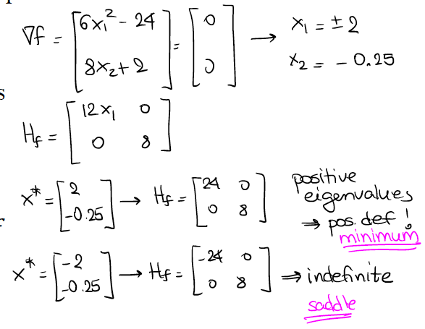
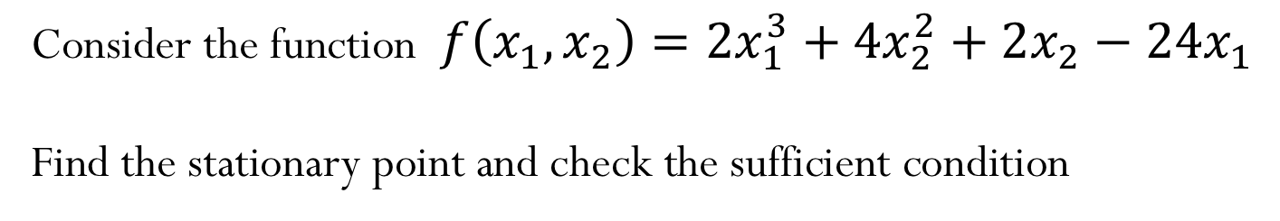
Example (ND)
Consider the function$f\left(x_{1},x_{2}\right)=2x_{1}^{3}+4x_{2}^{2}+2x_{2}−24x_{1}$
Find the stationary point and check the sufficient condition

Slide 14
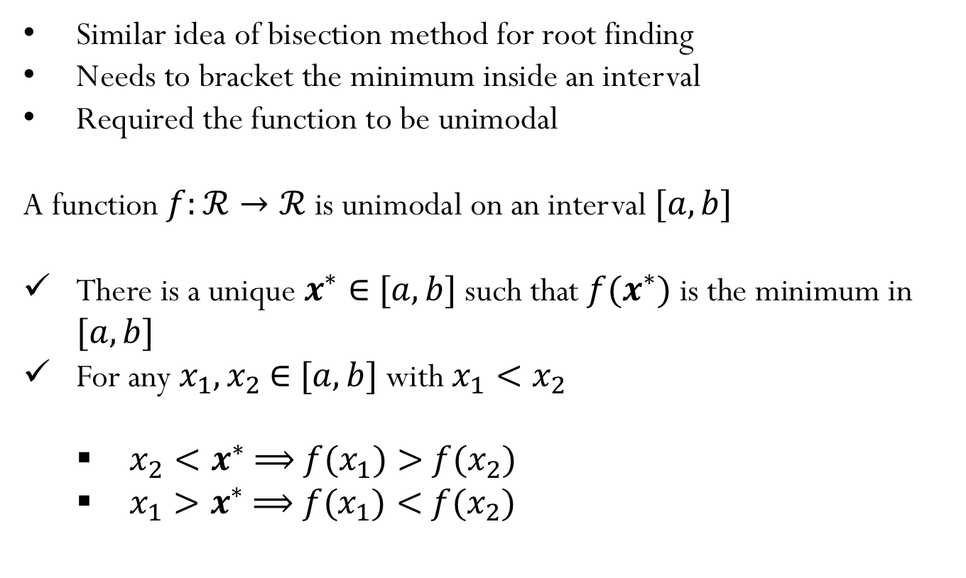
Optimization in 1D: Golden Section Search
Similar idea of bisection method for root finding
Needs to bracket the minimum inside an interval
Required the function to be unimodal
A function $f:ℛ→ℛ$ is unimodal on an interval $[a,b]$
There is a unique $x^{∗}∈$ $[a,b]$ such that $f(x^{∗})$ is the minimum in $[a,b]$
For any $x_{1},x_{2}$ $∈$ $[a,b]$ with $x_{1}<x_{2}$
$x_{2}<x^{∗}$ $⟹$ $f(x_{1})>$ $f(x_{2})$
$x_{1}>x^{∗}$ $⟹$ $f(x_{1})<$ $f(x_{2})$

Slide 15
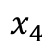
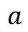
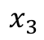
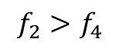
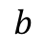
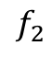
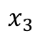
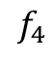
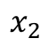
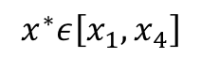
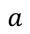
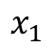
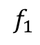
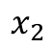
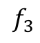
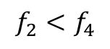
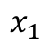
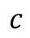
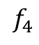








$$f_{1}$$
$$f_{1}$$
$$f_{3}$$
$$f_{3}$$
$$f_{4}$$
$$f_{2}$$
$$f_{2}$$
$$f_{4}$$
$$x_{1}$$
$$x_{2}$$
$$x_{4}$$
$$x_{3}$$
$$x_{1}$$
$$x_{2}$$
$$x_{4}$$
$$x_{3}$$
$$c$$
$$c$$
$$a$$
$$a$$
$$b$$
$$b$$
$$f_{2}<f_{4}$$
$$f_{2}>f_{4}$$
$$x^{∗}ε\left[x_{1},x_{4}\right]$$
$$x^{∗}ε\left[x_{2},x_{3}\right]$$
Such method would in general require 2 new function evaluations per iteration. How can we select the points $x_{2},x_{4}$ such that only one function evaluation is required?

Slide 16


Golden Section Search

Slide 17

Demo: Golden Section Proportions
Golden Section Search
What happens with the length of the interval after one iteration?
$$h_{1}={τ h}_{o}$$
Or in general: $h_{k+1}={τ h}_{k}$
Hence the interval gets reduced by $τ$
(for bisection method to solve nonlinear equations, $τ$=0.5)
For recursion:
$${τ h}_{1}={(1−τ) h}_{o}$$
$${τ τ h}_{o} ={(1−τ) h}_{o}$$
$$τ^{2}=(1−τ)$$
$$τ=0.618$$

Slide 18

Golden Section Search
Derivative free method!
Slow convergence:
$$\lim_{k→∞}{\frac{|e_{k+1}|}{\left|e_{k}\right|}=0.618 r=1 (linear convergence)}$$
Only one function evaluation per iteration

Slide 19

Iclicker question
Notes:
C

Slide 20






Newton’s Method
Using Taylor Expansion, we can approximate the function $f$ with a quadratic function about $x_{0}$
$f\left(x\right)≈f\left(x_{0}\right)+f^{′}\left(x_{0}\right) (x−x_{0})+\frac{1}{2}$ $f^{′}′\left(x_{0}\right) {({x−x}_{0})}^{2}$
And we want to find the minimum of the quadratic function using the first-order necessary condition
$$f^{′}\left(x\right)=0$$
$$f^{′}\left(x_{0}\right) +f^{′}′\left(x_{0}\right)({x−x}_{0})=0$$
$$h=\frac{−f^{′}\left(x_{0}\right)}{f^{′′}\left(x_{0}\right)}$$
$$h=({x−x}_{0})$$
Note that this is the same as the step for the Newton’s method to solve the nonlinear equation $f′\left(x\right)=0$

Slide 21

Newton’s Method
Algorithm:
$$x_{0}=starting guess$$
$$x_{k+1}=x_{k}−f′\left(x_{k}\right)/f′′\left(x_{k}\right)$$
Convergence:
Typical quadratic convergence
Local convergence (start guess close to solution)
May fail to converge, or converge to a maximum or point of inflection
Demo: ”Newton’s method in 1D”
And “Newton’s method Initial Guess”

Slide 22

Newton’s Method (Graphical Representation)

Slide 23

Iclicker
Consider the function $f\left(x\right)=4 x^{3}+2{ x}^{2}+5 x+40$
If we use the initial guess $x_{0}=2$, what would be the value of $x$ after one iteration of the Newton’s method?
$x_{1}=2.852$
$x_{1}=1.147$
$x_{1}=3.173$
$x_{1}=0.827$
NOTA
Notes:
D

Slide 24


Optimization in ND: Steepest Descent Method
$$f\left(x_{1},x_{2}\right)={(x_{1}−1)}^{2}+{(x_{2}−1)}^{2}$$
Given a function $f\left(x\right):ℛ^{n}→ℛ$ at a point $x$, the function will decrease its value in the direction of steepest descent: $−∇f\left(x\right)$
Iclicker question:
What is the steepest descent direction?
Notes:
Add arrows to the plot with different options for the direction

Slide 25




Steepest Descent Method
Start with initial guess:
$$x_{0}=\left[\begin{matrix}3 \\ 3\end{matrix}\right]$$
$$f\left(x_{1},x_{2}\right)={(x_{1}−1)}^{2}+{(x_{2}−1)}^{2}$$
Check the update:
$$x_{1}=x_{0}−∇f\left(x_{0}\right)$$
$$∇f\left(x\right)=\left[\begin{matrix}2(x_{1}−1) \\ 2(x_{2}−1)\end{matrix}\right]$$
$$x_{1}=\left[\begin{matrix}3 \\ 3\end{matrix}\right]−\left[\begin{matrix}4 \\ 4\end{matrix}\right]=−\left[\begin{matrix}1 \\ 1\end{matrix}\right]$$
How far along the gradient direction should we go?

Slide 26

Steepest Descent Method
Update the variable with:
$$x_{k+1}=x_{k}−α_{k}∇f\left(x_{k}\right)$$
How far along the gradient should we go? What is the “best size” for $α_{k}$?
0
0.5
1
2
Cannot be determined
$$f\left(x_{1},x_{2}\right)={(x_{1}−1)}^{2}+{(x_{2}−1)}^{2}$$
Notes:
B

Slide 28

Steepest Descent Method
Algorithm:
Initial guess: $x_{0}$
Evaluate:${ s}_{k}=−∇f\left(x_{k}\right)$
Perform a line search to obtain $α_{k}$ (for example, Golden Section Search)
$$α_{k}=\underset{α}{argmin}{f\left(x_{k}+α{ s}_{k}\right)}$$
Update: $x_{k+1}=x_{k}+α_{k}{ s}_{k}$

Slide 29


Slide 30
Steepest Descent Method
Demo: Steepest Descent
Convergence: linear
Demo: ”Steepest Descent”

Slide 31





Iclicker question:
Consider minimizing the function
$$f\left(x_{1},x_{2}\right)={10(x_{1})}^{3}−{\left(x_{2}\right)}^{2}+x_{1}−1$$
Given the initial guess
$$x_{1}=2,{ x}_{2}=2$$
what is the direction of the first step of gradient descent?
A) $\left[\begin{matrix}−61 \\ 4\end{matrix}\right]$
C) $\left[−\begin{matrix}120 \\ 4\end{matrix}\right]$
B) $\left[\begin{matrix}−61 \\ 2\end{matrix}\right]$
D) $\left[\begin{matrix}−121 \\ 4\end{matrix}\right]$
Notes:
D

Slide 32






Newton’s Method
Using Taylor Expansion, we build the approximation:
$$f\left(x+s\right)≈f\left(x\right)+{∇f\left(x\right)}^{T}s+\frac{1}{2}s^{T}H_{f}\left(x\right) s=\hat{f}\left(s\right)$$
And we want to find the minimum $\hat{f}\left(s\right),$ so we enforce the first-order necessary condition
$$∇f\left(x\right) +\frac{1}{2}2 H_{f}\left(x\right) s=0$$
$$∇\hat{f}\left(s\right)=0$$
$$H_{f}\left(x\right) s=−∇f\left(x\right)$$
Which becomes a system of linear equations where we need to solve for the Newton step $s$
Notes:
Hessian is related to the curvature, how fast my function is “curving” and therefore it gives the idea of how much the step should be

Slide 33

Newton’s Method
Algorithm:
Initial guess: $x_{0}$
Solve:${{ H}_{f}\left(x_{k}\right) s}_{k}=−∇f\left(x_{k}\right)$
Update: $x_{k+1}=x_{k}+{ s}_{k}$
Note that the Hessian is related to the curvature and therefore contains the information about how large the step should be.

Slide 34





Iclicker question
To find a minimum of the function $f\left(x,y \right)=3x^{2}+{2y}^{2}$, which is the expression for one step of Newton’s method?
A) $\left[\begin{matrix}x_{k+1} \\ y_{k+1}\end{matrix}\right]=\left[\begin{matrix}x_{k} \\ y_{k}\end{matrix}\right]−{\left[\begin{matrix}6 & 0 \\ 0 & 4\end{matrix}\right]}^{−1}\left[\begin{matrix}{6x}_{k} \\ {4y}_{k}\end{matrix}\right]$
B) $\left[\begin{matrix}x_{k+1} \\ y_{k+1}\end{matrix}\right]=−{\left[\begin{matrix}6 & 0 \\ 0 & 4\end{matrix}\right]}^{−1}\left[\begin{matrix}{6x}_{k} \\ {4y}_{k}\end{matrix}\right]$
C) $\left[\begin{matrix}x_{k+1} \\ y_{k+1}\end{matrix}\right]={\left[\begin{matrix}6 & 0 \\ 0 & 4\end{matrix}\right]}^{T}\left[\begin{matrix}{6x}_{k} \\ {4y}_{k}\end{matrix}\right]$
D) $\left[\begin{matrix}x_{k+1} \\ y_{k+1}\end{matrix}\right]=\left[\begin{matrix}x_{k} \\ y_{k}\end{matrix}\right]−{\left[\begin{matrix}6 & 0 \\ 0 & 4\end{matrix}\right]}^{T}\left[\begin{matrix}{6x}_{k} \\ {4y}_{k}\end{matrix}\right]$
Notes:
A

Slide 35

Iclicker question:
$$f\left(x,y \right)=0.5x^{2}+{2.5y}^{2}$$
When using the Newton’s Method to find the minimizer of this function, estimate the number of iterations it would take for convergence?
A) 1 B) 2-5 C) 5-10 D) More than 10 E) Depends on the initial guess
Notes:
Newton’s method will find the minimizer in one step since the function is quadratic (and in this case the quadratic approximation of the method is actually the exact function)

Slide 36

Newton’s Method Summary
Algorithm:
Initial guess: $x_{0}$
Solve:${{ H}_{f}\left(x_{k}\right) s}_{k}=−∇f\left(x_{k}\right)$
Update: $x_{k+1}=x_{k}+{ s}_{k}$
About the method…
Typical quadratic convergence ☺
Need second derivatives ☹
Local convergence (start guess close to solution)
Works poorly when Hessian is nearly indefinite
Cost per iteration: $O(n^{3})$
Demo: ”Newton’s method in n dimensions”

Slide 37

Demo: ”Newton’s method in n dimensions”
Example:
https://en.wikipedia.org/wiki/Rosenbrock_function
Notes:
Long thin valleys happen often and multi-dimensional problems, and Newton method is very efficient for this.

Slide 38

Iclicker question:
Recall Newton's method and the steepest descent method for minimizing a function $f\left(x\right):ℛ^{n}→ℛ$. How many statements below describe the Newton Method’s only (not both)?
Convergence is linear
Requires a line search at each iteration
Evaluates the Gradient of $f\left(x\right)$ at each iteration
Evaluates the Hessian of $f\left(x\right)$ at each iteration
Computational cost per iteration is $O(n^{3})$
A) 1 B) 2 C) 3 D) 4 E) 5
Notes:
Steepest Descent
Steepest Descent
Both
Newton’s method
Newton’s method
Answer is B)

